Slide 1

Retail Clienteling
Vision
Empower store teams to build meaningful, data-driven relationships with consumers, driving retention, purchase frequency, and long-term brand loyalty through one-to-one communication.

Slide 2
CLIENTELING GAP ANALYSIS
Retail Clienteling drives personalized engagement, boosts traffic and conversion, and equips associates with data-driven insights leading to a projected sales lift of 2% in year one and 5% by year three.
3-Year Incremental Revenue: $56.8 Million Globally*
Gap
Use Case
Value
Empower store managers to leverage their existing local customer base to increase purchase frequency and foster brand loyalty through targeted clienteling strategies.
Store Managers have no tools to drive traffic to stores
Increased Traffic and Conversion
Associates deliver personalized shopping experiences by sending customized post-purchase thank you messages and product recommendations via SMS or email.
No one-to-one Communication Methods
Increased Traffic and Conversion
Associates tag in-store consumer insights to enrich centralized profiles, enabling deeper personalization and more effective clienteling.
Incomplete consumer profiles
Complete Customer 360 Profiles
*New for North America, EMEA and Japan.
UGG China was used as a baseline, currently driving 1.5% of business through WeChat for H1 FY26 and not included in ROI calculations.
ROI Calculator

Slide 3




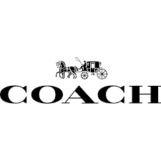
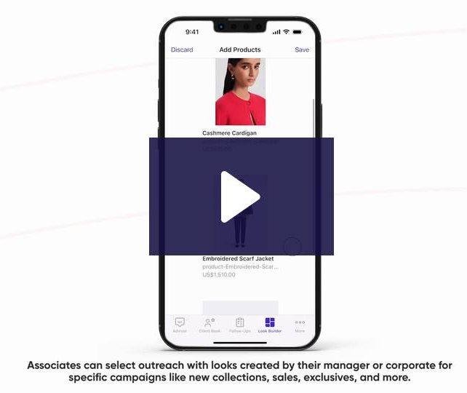
INDUSTRY EXAMPLES
“78% of shoppers are more likely to re-purchase after personalized communication” – Tulip, a leading vendor in clienteling space.
FRAME is a dynamic fashion brand that blends Californian essence with European sophistication.
Gorjana is a jewelry brand known for its stylish pieces designed for everyday wear and layering.
Coach is a global brand known for high-quality leather goods, accessories and apparel.
CLIENTELING SUCCESS:
Direct SMS campaigns achieving 11% conversion rate.
Average order value for clienteling sales are $81 higher than average order value.
CLIENTELING SUCCESS:
Gorjana’s SMS messages have an average 8.4% conversion rate.
Most customers convert within 7 days of contact.
Direct replies to one-to-one messages yield a 20% conversion rate.
CLIENTELING SUCCESS:
48% higher average order value from clienteling.
73% increase in sales clienteling.
Sales from clienteling have grown 68%
Clienteling Demo Video | Tulip

Slide 4





OPTIMIZED CONSUMER JOURNEYS WITH CLIENTELING
Consumer Leaves Empty Handed
Product Launches
Purchase Follow Up
Special Occasion Shopping
Identify VIPs
Current
Consumer can’t find desired item; associate offers alternatives, but consumer leaves without purchasing. Might shop online.
VIP shopper enters the store; Associate may recognize them and offer elevated service.
Consumers receive email alerts for new product launches. If shopping in store they may see new VM callouts.
Consumer receives an e-receipt from purchase, and a reminder email to take our VoC survey.
Consumer shops on or near their special occasion. Associate has no prior context, so the interaction is generic
Consumer can’t find desired item; associate accesses customer profile, preferences and purchase history to suggest tailored alternatives or offer to notify when item is available. Customer feels valued and may commit to future purchase.
Associate proactively invites VIP shopper to the store with updates on desired items, events or promotions. Upon arrival, the shopper is greeted personally, with recommendations based on past purchases and preferences creating a personalized experience.
Consumer visits a store and is interested in upcoming product launches. Associate logs in clienteling app, and notifies them when the item arrives, can link to online for direct purchase or invite to the store.
Associate sends a personalized thank you message post purchase, building trust and loyalty. Follow-up may include product care tips, complementary items or event invites, which deepens engagement and encourages quicker return visits.
Associate proactively reaches out ahead of key date with curated suggestions. They may offer gift wrapping, hold items, or schedule a styling appointment. This creates a thoughtful, memorable personal experience where the consumer feels valued.
With Clienteling

Slide 5
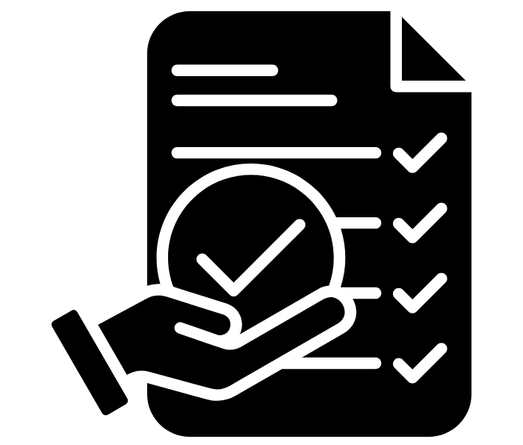
CLIENTELING STRATEGY
4-Step Clienteling Flow
CAPTURE
ENGAGE
CONVERT
RETAIN
Collect data at POS or consumer interaction
Personalized outreach within 48-hours
Drive second purchase within 30 days
Continuously engage in ongoing clienteling journey
Drive Store Accountability
Store-Level Dashboards: Visualize traffic drivers, client retention, and new customer acquisition.
KPIs by Associate: Track outreach, follow-ups, and conversion rates.
Clienteling Scorecards: Measure engagement quality and customer outcomes.
Existing Consumers
Goal: Increase retention and purchase frequency
Tactics:
  Personalized post-purchase follow-ups
  Events and special occasion outreach
New Consumers
Goal: Convert to loyal consumers
Tactics:
  Increase customer capture for new consumers
  Drive second purchase

