Slide 1
EDI E2E Growth in EMEA – Business Case Summary
August 2025

Slide 2
EDI Business Case - Recommendation
This business case recommends moving away from our current global EDI provider, SPS Commerce, implementing a modern, regionally established, Electronic Data Interchange (EDI) platform across DECKERS EMEA and partner ecosystem. EDI will automate the exchange of business documents (POs, ASNs, Invoices, Sales Reporting, Product Data etc.) with wholesale strategic or volume accounts, replacing legacy methods (email, paper, PDFs) and manual intervention.
The proposal is for a best fit partner across the full order-to-cash cycle but with initial targeted focus onboarding accounts with sell through data to unlock the highest ROI capability. From an order-to-cash cycle and based on our integration readiness, we should take opportunities to transition invoicing to release benefits here and automate the invoice process. As our OM capabilities are assessed and future architecture evaluated, we layer on the wider scope of messaging and remove our manual order entry needs for high volume, non B2B accounts.
Initial indications and review of the market would position Btwentyfour as that partner with established connections across our top billing accounts and significant coverage across all key accounts, a coverage which we believe outperforms any competitor across the market.
Strategic Drivers
Driver | Description
Operational Efficiency | Eliminate manual document handling and errors, accelerate cycle times
Global Standardization | Ensure consistent B2B transaction formats and compliance
Customer & Supplier Demands | Retailers and global partners increasingly mandate EDI
Cost Reduction | Cut transaction costs and reduce working capital tied to process delays
Scalability & Speed | Support rapid onboarding of partners across geographies and business lines
Notes:
Definition of EDI: Electronic data interchange (EDI) is the automated exchange of business documents between organizations. Daily business workflows require the exchange of documents like invoices, purchase orders, and shipping forms. Traditionally, paper-based documents or emails with attachments are shared between company representatives, who then manually process and fill the document data in their enterprise data systems. EDI technology automates these workflows so that digital systems can share and process documents across organizational boundaries without human involvement. Organizations can connect IT systems to others in their B2B network to save time and eliminate errors from manual processing.
(Source: https://aws.amazon.com/what-is/electronis-data-interchange.)

Slide 3
Roadmap & Timeline – E2E Order-to-Cash model*
* Sell through realisation through Data & AI team – not outlined in detail here
Part 1: Project Mobilisation | Months 1-5 | Project approved, vendor selection, resources onboarded
Part 2: Project Stabilisation | Months 4-6 | PM in place, Architect create current, transition and end states. Data flow patterns agreed globally.
Part 3: Invoice Network | Months 6-10 | Initial targets onboarded, transaction validations
Part 4: OM Network | Months 9-13 | Initial targets onboarded for order management
Part 5: SPS Transition | Months 11-13 | Current EDI accounts via SPS moved to B2B, transitioned to 1 provider.
Part 6: BAU | Months 14+ | Follow target plan to onboard from playbooks, support model in place.
FY26 Q2 Jul – Sep (2025) | Q3 Oct – Dec (2025) | Q4 Jan – Mar (2026) | FY 27 Q1 Apr – Jun (2026) | FY27 Q2 Jul – Sep (2026)
PROJECT MOBILISATION / STABILISATION
RFP (IF NEEDED)
Businesss
Case
Approval
Project
Approval
ARCH & SOLUTION STATES AGREED
Architect off project
PM allocated
D&D team onboarded
Project Closes
INVOICE NETWORK
INV OUT INTEGRATION API
EDI ESTABLISHED
Top Target billing accounts on EDI
BAU
EDI TAKEUP
OM NETWORK
OM INTEGRATION APIs
EDI ESTABLISHED
Top Target Strategic accounts on EDI
EXISTING FROM SPS TO B24
Single EDI Provider
SPS EDI TRANSITION

Slide 4
EMEA: ROI for change in EDI provider & capability expansion
Benefits Quantitative
Sales Acceleration
Reduced Close out Sales Wholesale
Reduced Inventory Holding Costs
Labour Savings from Order Automation
Chargebacks
Benefits Qualitative
Deepened Partner Relationships from:
  Service elevation, ease of doing business, security/confidentiality risk reduction (paper invoices contain pricing, discount, terms), improved customer trust
Re-purposed hours to value-add tasks resulting from:
  Operational efficiencies: reduce manual order management and errors, improved speed to market, more accurate invoice delivery, fewer disputes
  Scalability: growth support without headcount increase
Assumptions subject to change: as at 28 July 25
Notes:
Sell Through:
Blind spots in consumer demand lead to missed revenue opportunities or excess inventory. When we can identify real time sales trends by product, region and channel, we can better align production and replenishment schedules with true consumer demand.
Without sales data we have a much less agile response to market shifts, especially in a volatile macro environment or changing fashion trends. This can cause overproduction and a misallocation of product with customers.

Slide 5
EMEA: ROI for change in EDI provider & capability expansion
Assumptions (ROI):
ROI based on confirmed account coverage by B24 as at 23 July 25, and assuming ‘Enterprise’ package with B24 (CHF3,999 p/m).
FY25 Total Re –Orders ( 12%)
Total Pre-season (86.2%)
Total Close out (1.8%)
Closeout Margin 30%
Full Price Margin 55%
Short term sales growth driven by strong re-order uplift
Long term sales uplift due to better planning
1% reduction in residual units
Reduction in Chargebacks and resulting labour (0.05%)
Benefit Realisation & Phasing:
Implementation Months 0–6 System setup, retailer integration, data mapping, PIM configuration
Stabilization Months 6–9 EDI messages flowing, sell-through dashboards functional, training complete
Initial ROI (soft gains) Months 9–12 Reduced errors, early reorders, labor savings begin
Full ROI (hard gains) Year 2 onward Improved forecasting, fewer closeouts, sales uplift measurable
Principles (Delivery):-
Phased approach: Initial focus on high ROI area and transition from SPS for sell through connections.
Approach (Delivery)
Delivery through Data & AI team as part of global initiative for sell through reporting.
Wider transition from SPS and scalable growth with B24 for OM EDI driven through regional D&D.
Considerations (Delivery)
Wider use of EDI capabilities with B24 linked to contract removal with SPS and interdependencies with other programs (Boomi API – post cloud move, OMS)
Business ownership of EDI in region and D&D service support model to be defined.

Slide 6
Project Delivery / BAU: Business Ownership and Key Roles?
In NA, the business relationship with the EDI partner and determination of the accounts to target for onboarding is with Customer Experience. This considers targets from sales and finance.
For EMEA:
We have key targets for EDI across the functions that may differ. Who will have ownership for determining, based on business needs & value, sequence and priority of accounts to target? If or when new message types are needed and benefit evaluation of this work?
Recommendation & consensus in EMEA Leadership:
  Any service contracts with the provider and costs sit on the D&D side. We will own the service relationship.
  The central business ownership would be with CS OPS.
    Will co-create a monthly or quarterly review with sales, credit & OM team to review current in-flight work, next targets agreed based on benefit metrics.
Notes:
The responsibilities of an EDI business owner include:
Developing an Implementation Plan: Assess current business needs and set realistic goals for EDI implementation.
Identifying Key Stakeholders: Determine roles and responsibilities within the EDI implementation process.
Setting Clear Goals and Expectations: Align EDI implementation with business objectives and manage expectations effectively.
These responsibilities are crucial for successfully integrating EDI into the business operations

Slide 7
Way forward…
Approval on the enterprise program and schedule in.
Confirm position for running 2 EDI providers in transition and non-renewal with SPS.
Approval to recruit additional resources to deliver.
Assign PM
Engage with B24 & EMEA Procurement
Confirm ownership model with EMEA stakeholders and identify key resources in non-D&D teams.

Slide 8
APPENDIX: ADDITONAL INFORMATION

Slide 9
EDI Business Case
Risks & Mitigation
Risk | Mitigation
Partner Resistance | Provide incentives, EDI onboarding tools, flexible integration options, leverage EDI connections they have in place.
Data Mapping Complexity | Use pre-built maps/templates from EDI providers for customer connections
Business Disruption Risk | Phased onboarding, dual-run testing, rollback capabilities
Multipling solutions for same capability | Include transition of accounts from SPS to B24.
Lack of internal resource / knowledge slowing take on. | Agree clear R&R with service provider for taking on customer connections and testing needs.
Strategic Alignment
Supply Chain Modernization | Foundation for real-time, resilient global supply chains
Digital Transformation | Enables automation and API-driven ecosystems
Customer Satisfaction | Reduces latency, increases accuracy, enhances SLAs
Sustainability Goals | Reduces paper, postage and manual processes

Slide 10
Project Delivery – Regional D&D Structure
STAKEHOLDER GROUP:
Felix, Vicky, Victoria, Kay, Stef, Guido
KIM (EMEA PMO)
DYLAN (EMEA D&D)
Project Manager
TBC
12 Month FTC
BUSINESS OWNER: TBC
Work prioritisation, roadmap planning, value owner.
Solution Architect
TBC
6 Month Contract
EDI ENGINEER
FTE
OM PROGRAM DESIGN TEAM
BOOMI API TEAM
CORE APPS ENGINEERS
Link into global OM design and decisions for architecture fit.
Link into Managed Service Team for on-going enhancements, defects and service incidents.

Slide 11
Project Delivery – Regional Structure: Resources needed…
Role | Project Manager | Solution Architect | EDI Engineer
Resource Status | Budget approval and recruitment required | Budget approval and recruitment required | Budget approval and recruitment required
Length | 12 month | 6 month | Perm
Value | This role is central to delivery for transition from one provider to another and set up to scale through BAU. They will manage from contract through to closure all project aspects. | A solutions architect here will develop the technical vision for the EDI solution. Guided by business requirements, they design, describe, and manage the technological solutions that make up this desired software architecture. They will connect and work with global D&D teams to understand architecture landscape and journey and design the transition and end state visions for building solution in line with our architectural principles. | EDI Analyst is responsible for managing our EMEA electronic data interchange system, ensuring efficient data exchange between organizations, and supporting business operations through technical solutions.
Key Responsibilities | Provide overall project leadership and management of all aspects of this initiative, including requirements gathering, solution/IT design and delivery, testing, change management and implementation/deployment. Structure and manage the delivery or implementation plan, including defining what needs to be done, how and when with stakeholders. This includes driving and agreeing the delivery method with IT teams. Effectively manage all risks, issues, assumptions, and dependencies. This includes anticipating and making trade-offs, balancing the business needs versus constraints. This would apply with both business and IT teams. | Create the overall technical vision for this business problem. They will analyse existing systems, identify inefficiencies, and design robust, scalable solutions that integrate seamlessly with current technology. Work closely with stakeholders to understand business needs and objectives, ensuring that the proposed solutions align with organizational goals. Assess various technologies and frameworks to determine the best fit for the project, considering factors like scalability, security, and compliance. Will serve as a bridge between technical teams and non-technical stakeholders, translating complex technical details into understandable terms for all parties involved. | Design, develop, test, implement and maintain our EDI system Coordinate EDI testing and trading partner implementation initiatives Provide technical support during the implementation Work closely with stakeholders to define requirements and develop solutions Analyse and design in co-ordination with API team enhancements and extensions in EDI applications, interfaces, and mappings Coordinate with trading partners in EDI design and implementation Monitor and report on EDI processes and transactions Ensure compliance with data security and privacy regulations

Slide 12
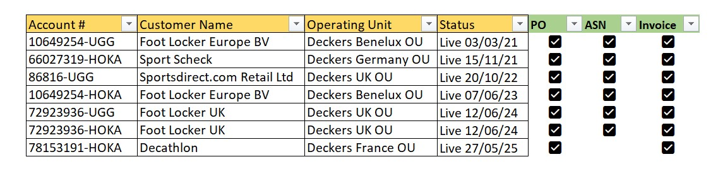
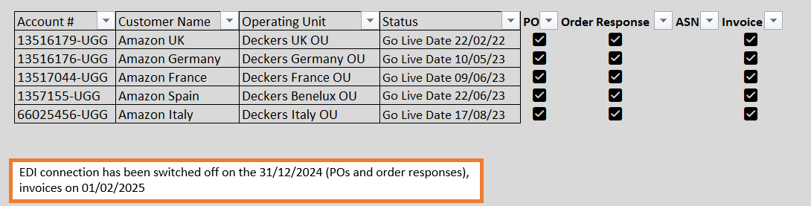
Current EDI in EMEA with SPS

Slide 13
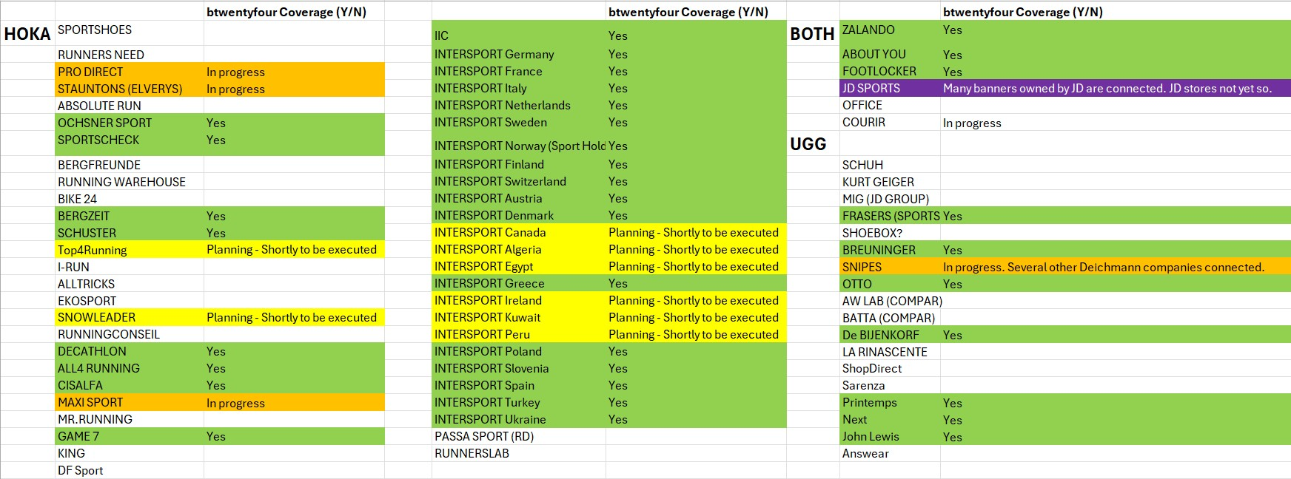
Examples of B24 current coverage of key accounts

