Slide 1
RETAIL REPLENISHMENT OPPORTUNITY

Slide 2
GLOBAL RETAIL STRATEGY HOUSE
$750M + 300 Owned Stores by FY29
ASPIRATION
North Star
VISION
Our Goal
Our Stores are the Pinnacle Expression of our Brands IRL.
MISSION
Why we exists / Our purpose
Create Best-in-Class Retail Experiences for our Consumers and Teams.
MARKETPLACE PRIORITIES
EXPAND Our Business | ELEVATE Brand Expression | ENGAGE Consumers & Teams
Accelerate the Pace and Growth of Stores Better Insights through Enhanced Analytics and Reporting Focus on core and emerging category growth and consumer segments Scale and Enhance Foundational Retail Operations | Develop Scalable Retail Concepts and Playbooks by format Produce Elevated and Consistent Storytelling and Brand Experiences Elevate the Consumer Journey with Modern Retail Technology​ Power Brand Presence in Key Cities | Identify and Obsess key Consumer Journeys Deepen Loyalty and Community ​in Stores Empower our Store Teams to be Brand Ambassadors Elevate the Retail Employee Experience
STRATEGIC PRIORITIES
& PLAYBOOK
How we’ll win
FY29 MEASURES
OF SUCCESS
What success looks like
$750M + 300 Owned Stores by FY29 HALO Impact | Elevated Brand Awareness + Consideration in Key Cities​ | Retail NPS Score: 90​ Customer Capture: 31% to 50%​ Employee Turnover / Engagement
CAPABILITIES OF FOCUS
Where we’ll prioritize investment
Outstanding Retail + People Leadership​ | Connected Consumer Journey | Data-Driven Insights​ | Scalable Retail Concepts + Programs | Invest in Strategic Relationships

Slide 3
FY25 GLOBAL OWNED RETAIL HAD A RECORD-BREAKING YEAR
APAC$151M
+13% Budget
+17% Comp Growth
EMEA$84M
NA
$254M
JAPAN$67M
+16% Budget
+13% Comp Growth
+27% Budget
+18% Comp Growth
+11% Budget
+23% Comp Growth
Global
$489M
CHINA$84M
+21% Budget
+16% Comp Growth
+16% Budget
+10% Comp Growth

Slide 4
GLOBAL RETAIL LRP
141
Stores
120
Stores
94
Stores
49
Stores
69
Stores
142
Stores
152
Stores
159
Stores
159
Stores
163
Stores

Slide 5
EXECUTIVE SUMMARY
Post-COVID – retail traffic continues to increase YoY
Young consumers, in particular, are craving in-store shopping experiences as a reprieve from the digital world
Consumers expectations around product availability/accessibility has risen, especially in the retail channel
Deckers Retail is now being viewed as a strategic channel to accelerate brand growth
NA SC team has spearheaded innovation in with AI (Syrup), which has given us new insights into our retail business. Such as the impact of replenishment time on
  Sales
  On Hand Inventory
There is significant value getting closer to our consumers
We will need strong partnership and some investment to unlock this value together

Slide 6
MANY FACTORS IMPACT REPLENISHMENT TIMING
Distribution Network/Geography
Allocation Frequency
Transportation/Logistics Cost
Consolidation Hubs
Size of Deliveries
Delivery Frequency
Back of House Capacity
Receiving Capacity (space)
Receiving Locations (Offsites vs Store)

Slide 7
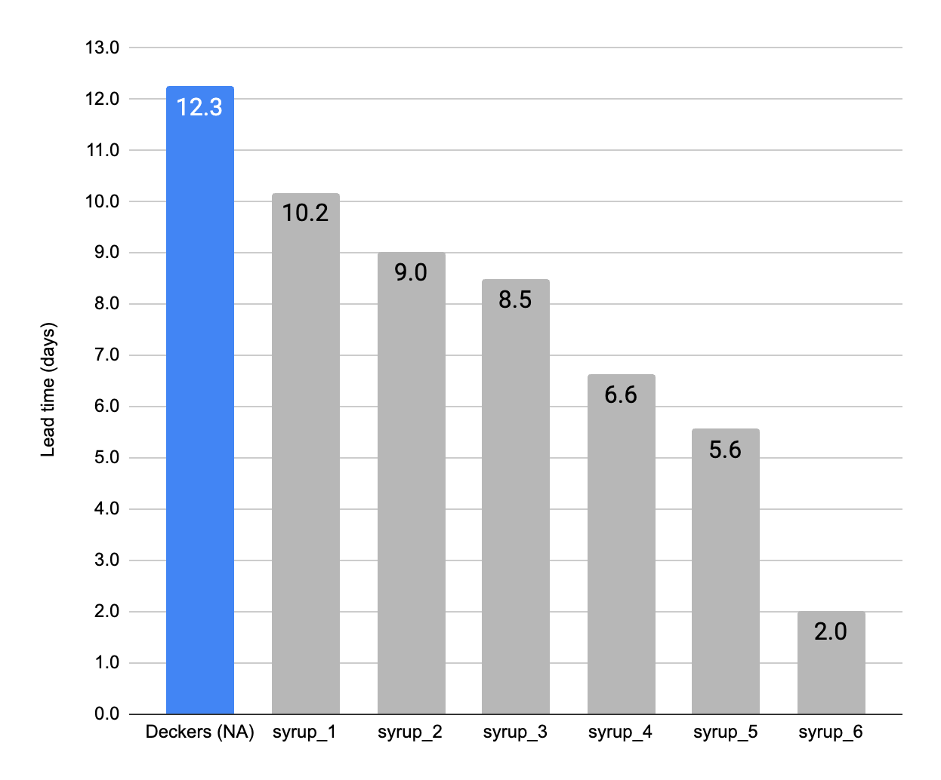
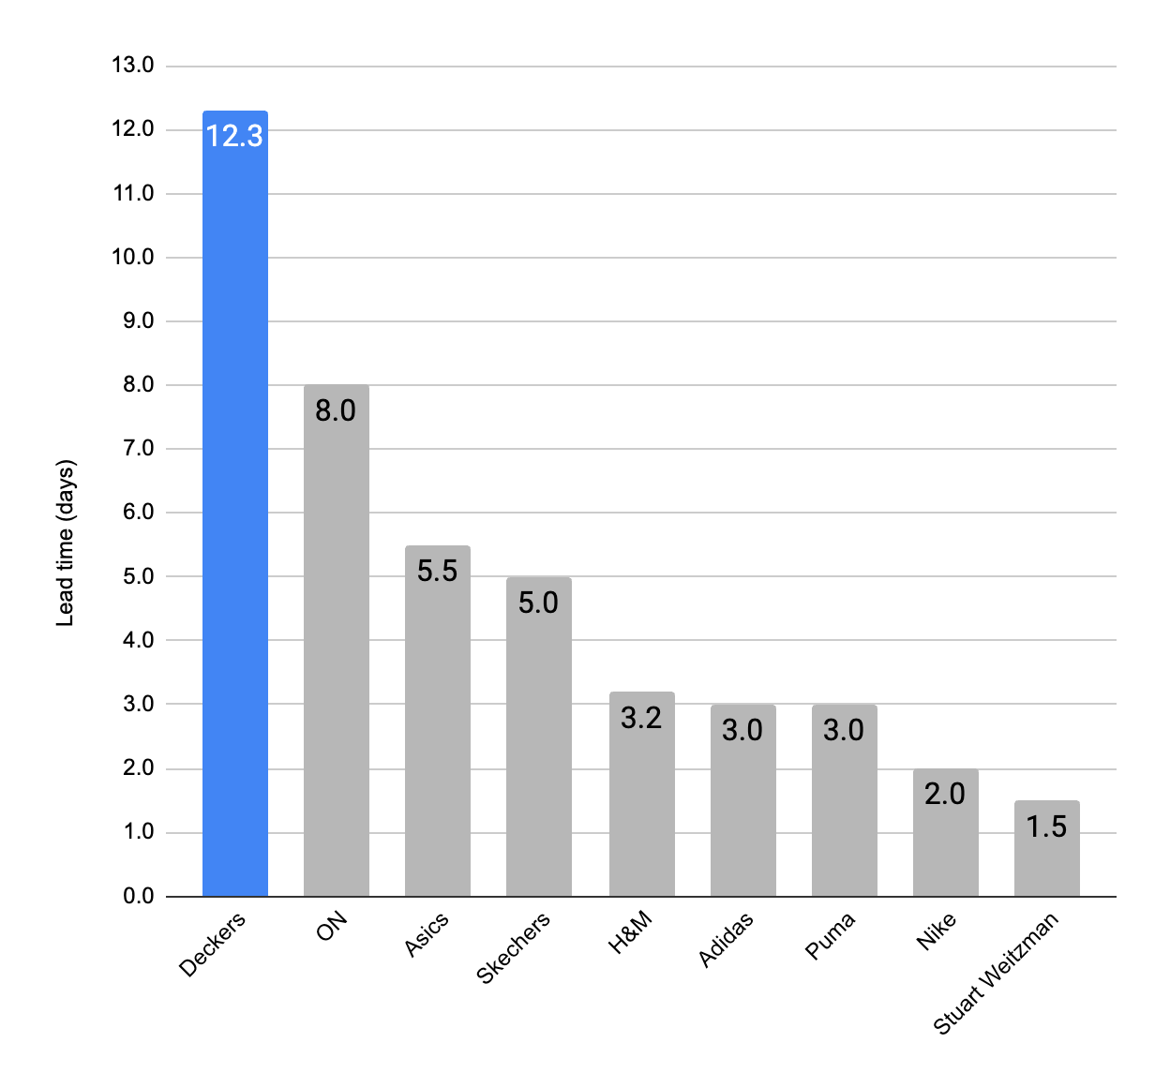
REPLENISHMENT TIMING NA BENCHMARKS
# of days from approved allocation to in-store receipt
Syrup Customer Avg:
7.0 days
Industry average:
4.0 days
Replen time (days)
Replen time (days)

Slide 8
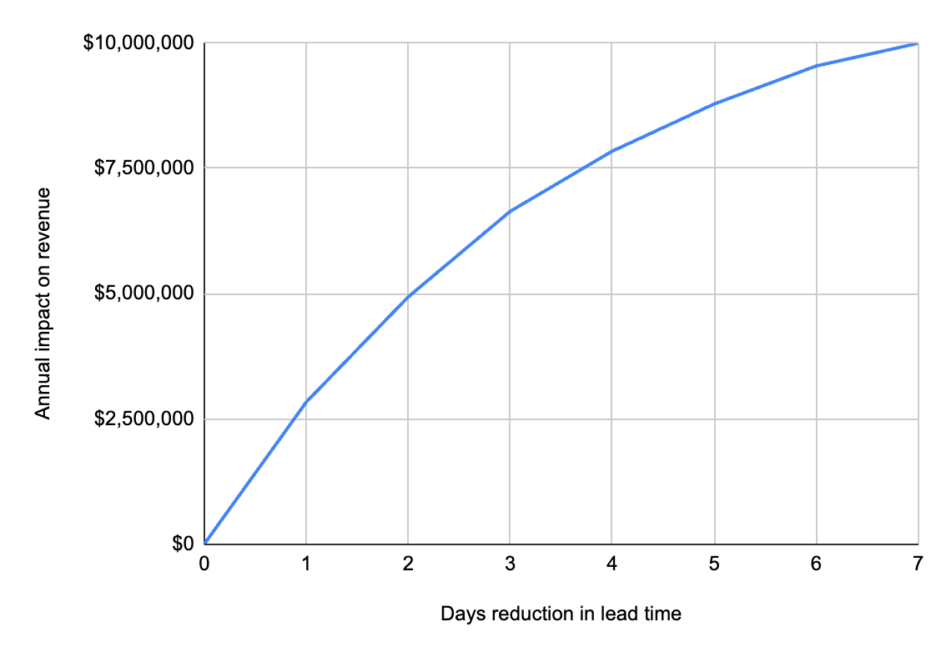
REVENUE POTENTIAL FROM QUICKER REPLENISHMENT
$10M Revenue Opportunity by reducing from 12 to 5 days
WHAT WE ACHEIVED
35% lower on hand inventory
20% fewer task labor hours
Days reduction in replen time

Slide 9
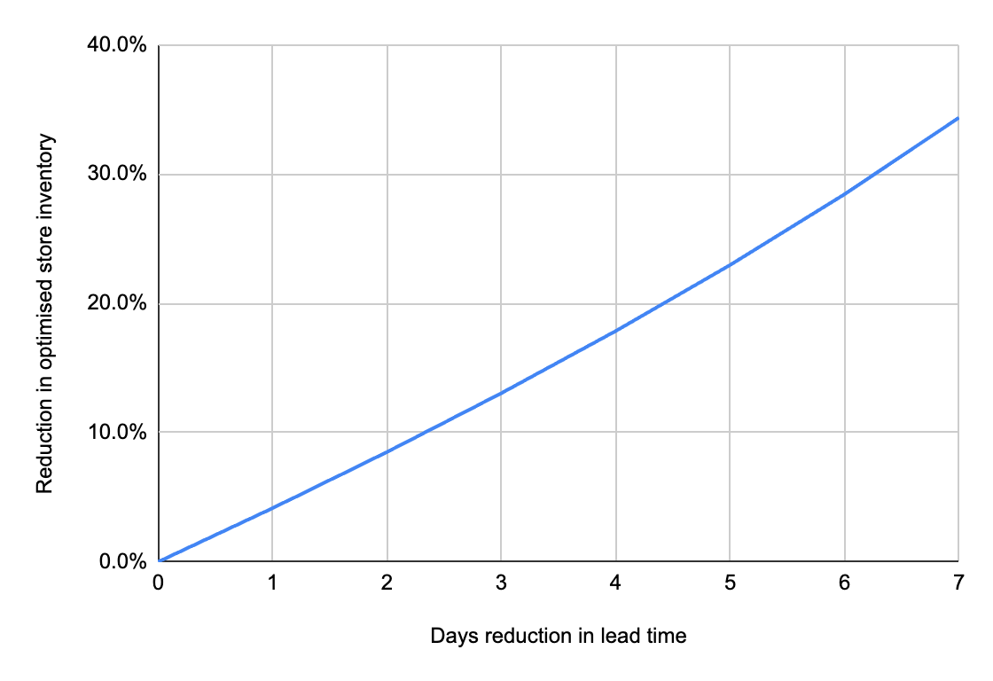
ON HAND INVENTORY
Reducing to 5 Day replenishment could reduce on-hand inventory by up to 27%
*this will not impact visual minimums. Avg units when in stock: 5.4, min: 1.5
27% Reduction Cap
Based on Planning & Allocation Estimates
Days reduction in replen time

Slide 10
ESTIMATED VALUE OF 5 DAY REPLENISHMENT
$10M Annual Revenue
$3.4M Reduction in Labor
$500k Reduction in Rent
$150k
Shrink Reduction
141
Stores
120
Stores
94
Stores
69
Stores
Less Inventory will require fewer offsites
10% inventory shrink reduction
$20M in lost sales avoided from units arriving earlier. 50% reduction for estimated cannibalization
Less inventory will require fewer store task hours
49
Stores
142
Stores
152
Stores
159
Stores
163
Stores
ESTIMATED VALUE: $14M

Slide 11
NEXT STEPS
Submit Business Case to D&D In-Take
Organize/Plan Cross-Functional Workshop

Slide 12
APPENDIX

Slide 13
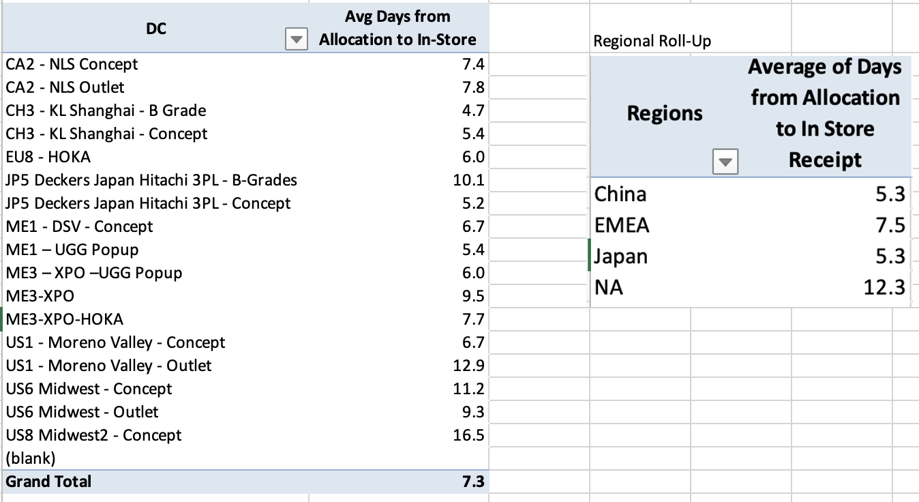
REPLENISHMENT TIMING BY REGION

Slide 14
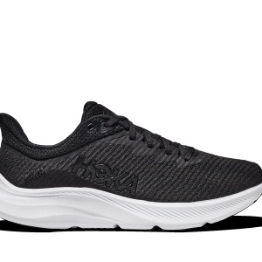
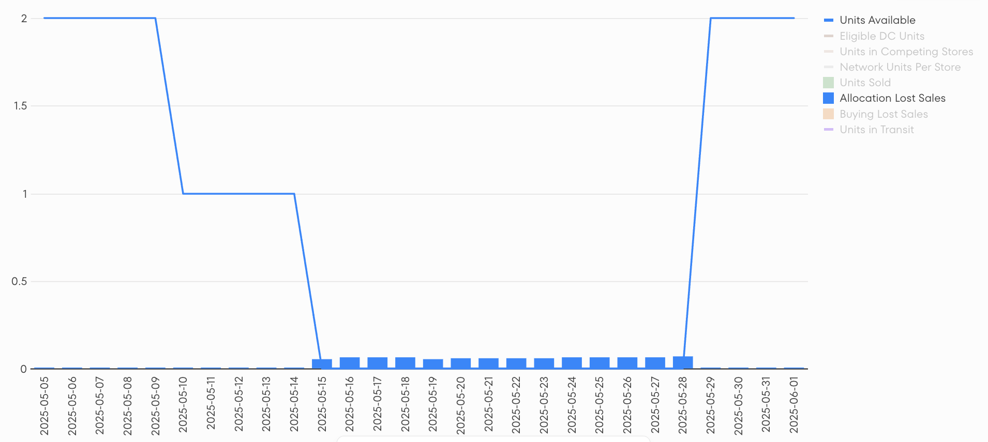
REDUCTION IN LOST SALES
Case study: impact of replen time on lost sales
W SOLIMAR SLIPPER (1123075-BWHT)
HOKA Flatiron - May 15th 2025
$3.84 per day in lost revenue - Based on estimated demand and 50% cannibalization
May 12th:
Units allocated
May 29th:
Units arrive

Slide 15
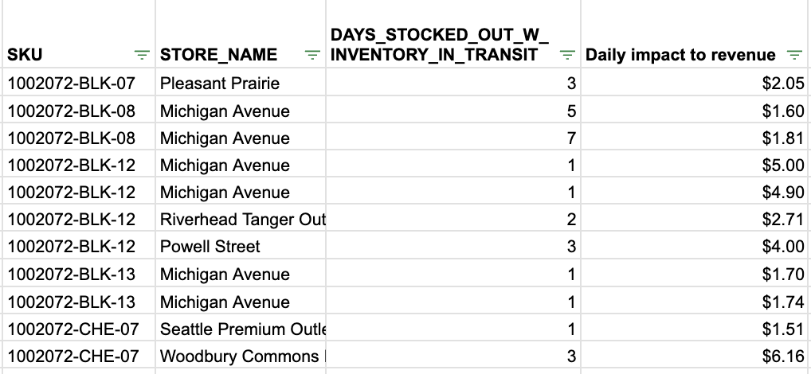
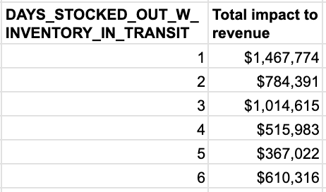
REDUCTION IN LOST SALES
Approach to calculating impact on revenue

Slide 16
REDUCTION IN ON HAND INVENTORY
Optimizing on hand inventory (“Dynamic WOS”)
Safety stock is too high
Optimised safety stock
Excess stock on shelves while the DC sits empty.
Wasted investment from unsold stock.
Forecasts
Forecast accuracy
  Store level
  System level
DC inventory
Historical lead times
Time until markdown
Real-world constraints
How often allocation decisions are made
Safety stock is too low
Avoidable mid-season stockouts.
Allocation complexity from low stock levels.

Slide 17
REDUCTION IN ON HAND INVENTORY
How long it takes to sell all the allocated units:
The next delivery arrives
DC runs out
of inventory
Markdown
or new PO
(e.g. 2 weeks)
(e.g. 8 weeks)
Lost sales from under-allocating
Mid-season stockout
while there is inventory
in the DC.
Optimised allocation
No lost sales were created.
Lost sales from over-allocating
This stock got trapped on the shelf while it could have sold in another store.
Aim for the mid-point of lead time (e.g. 2 weeks)
and markdown or DC WOS (e.g. 8 weeks)
=SQRT(2*8) = 4 weeks of supply

