Slide 1
Store Event Scheduling & Retail Mobile Queuing

Slide 2
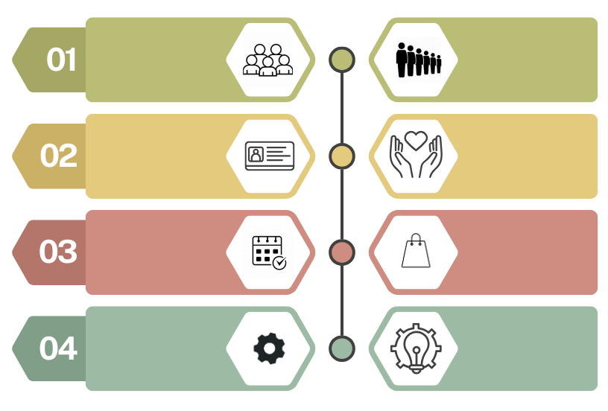

Problem Statement
Use Case
Value
Manage lines and better serve consumers during Peak.
Increase revenue & improve consumer experience/NPS
300-400k
We lose consumers to long lines.
It’s difficult to invite, register, and track consumers at retail events.
Enable stores to manage events & build community (e.g., run clubs).
Increase customer capture, generate event revenue, and drive meaningful consumer engagement
51-77k
We lack VIP event check-in (e.g., Feel House) and retail appointment capabilities.
Offer VIP event check-in and personalized shopping at flagships.
Drive traffic to stores and elevate VIP events & in-store experiences
46k
Current tools are standalone (non-integrated) with basic capabilities.
Empower teams with robust capabilities and integrated tools (e.g., CRM & POS).
POS/CRM integration enables enhanced data analytics capabilities and increases LTV
Total: 397-523k annually
8x – 11x ROI
Notes:
Opportunities
Flexible calendar enables easy experience management
Integrate into Amperity & POS – drive the connected journey
Enable enhanced data & analytics capabilities
Deepen consumer connection through personalization
Technology enables: Queue management, In-store experiences and events (e.g., run club, product launches, loyalty-based, educational), and other use cases (e.g., selling appointments).
Discovery is underway with five vendors

Slide 3
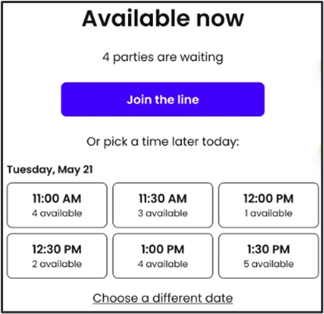

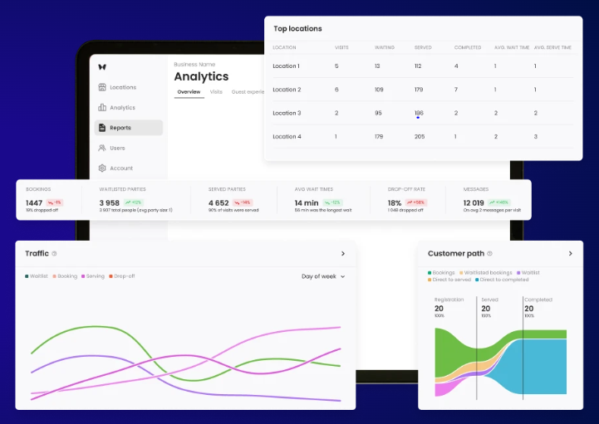
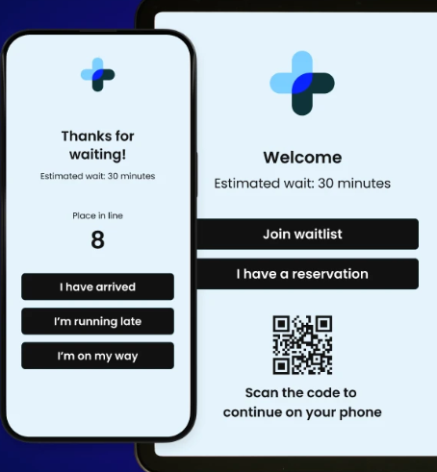
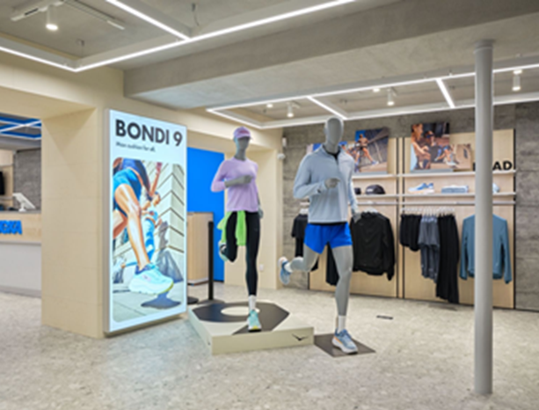
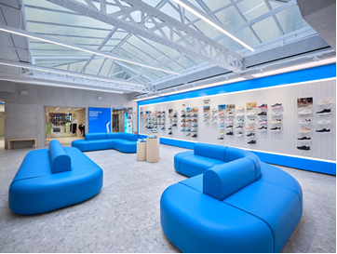
Bringing the Experience to Life
Booking
Analytics
Check-In
Minimize lost sales from long lines by implementing capabilities to reduce wait times, manage Peak crowds, streamline retail operations through data/analytics and deliver personalized consumer communications.

