Slide 1


EMEA Giftcard

Slide 2
MVP SCOPE :
ECOM REDEMPTION ONLY [until entity/crossborder issue has resolution]
UGG, HOKA & TEVA
NA TEMPLATES [where possible]
UK GBP ONLY
EGIFTCARD ONLY
COPY RETAIL RULES & REGULATIONS – EXPIRATION [24 months], T’S & C’S
FUTURE SCOPE :
EU EURO CURRENCY, enforcing locale redemption, Givex IIN
EXCL. GLOBALE CURRENCY AND SITES
DTC REDEMPTION – tech solution in discussion
EMEA TEMPLATES [where possible]
ALL MARKETS [excluding GlobalE where customer doesn’t transact with us]

Slide 3
CONSIDERATIONS :-
Browse and Purchase journey
Redemption Checkout journey
Checkout Auth and Redeem journey is unique for EMEA because Adyen implementation
Adyen split shipment exception scenario for DOMS
Oracle changes required for sku type {sku dependency as NA for consistency and visibility} to map to order type [separate to site coupon code] – known but not accounted for
Finance reconciliation and reporting – Existing retail reconciliation and reporting on deferred revenue, sku dependency as NA for consistency and visibility
Legal – laws expiration
TAX/VAT implications
Impacted teams assessment [Ops, CS, CRM]

Slide 4
Purchase flow
Content slots/Browse
PDP
Mini cart
Cart
Checkout
Email

Slide 5
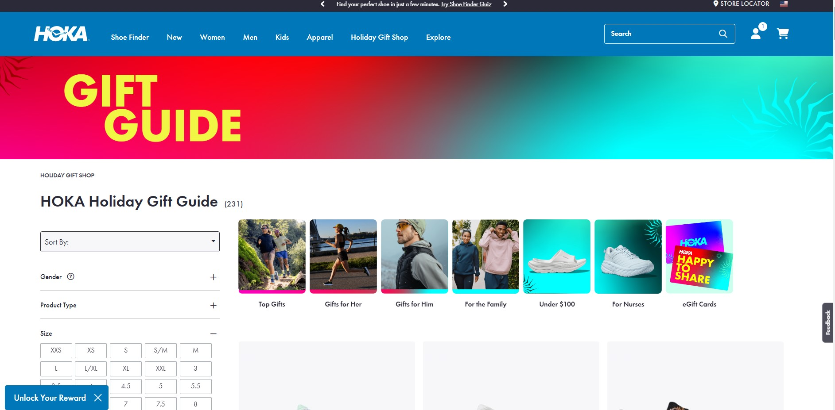

Slide 6
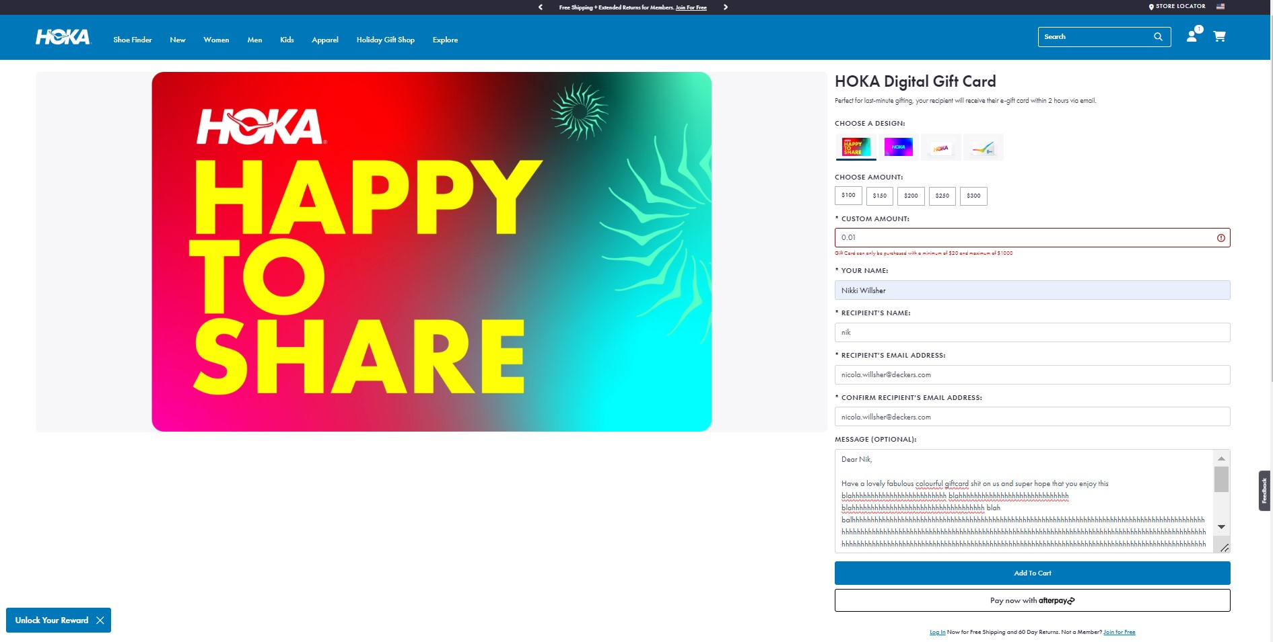

Slide 7
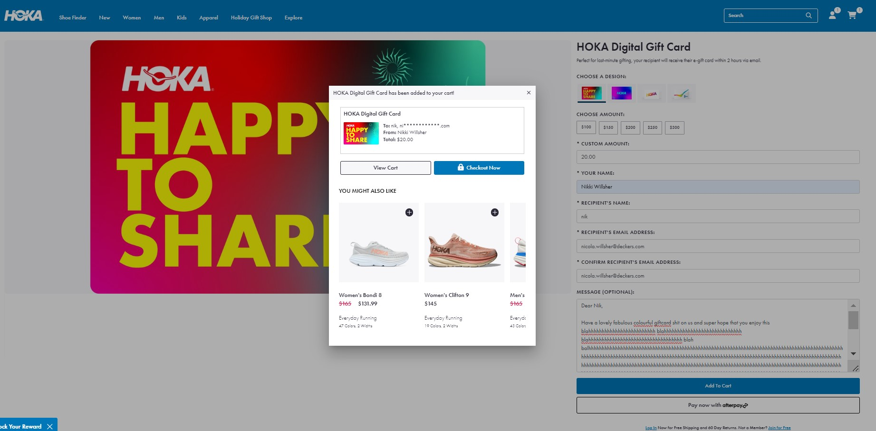

Slide 8
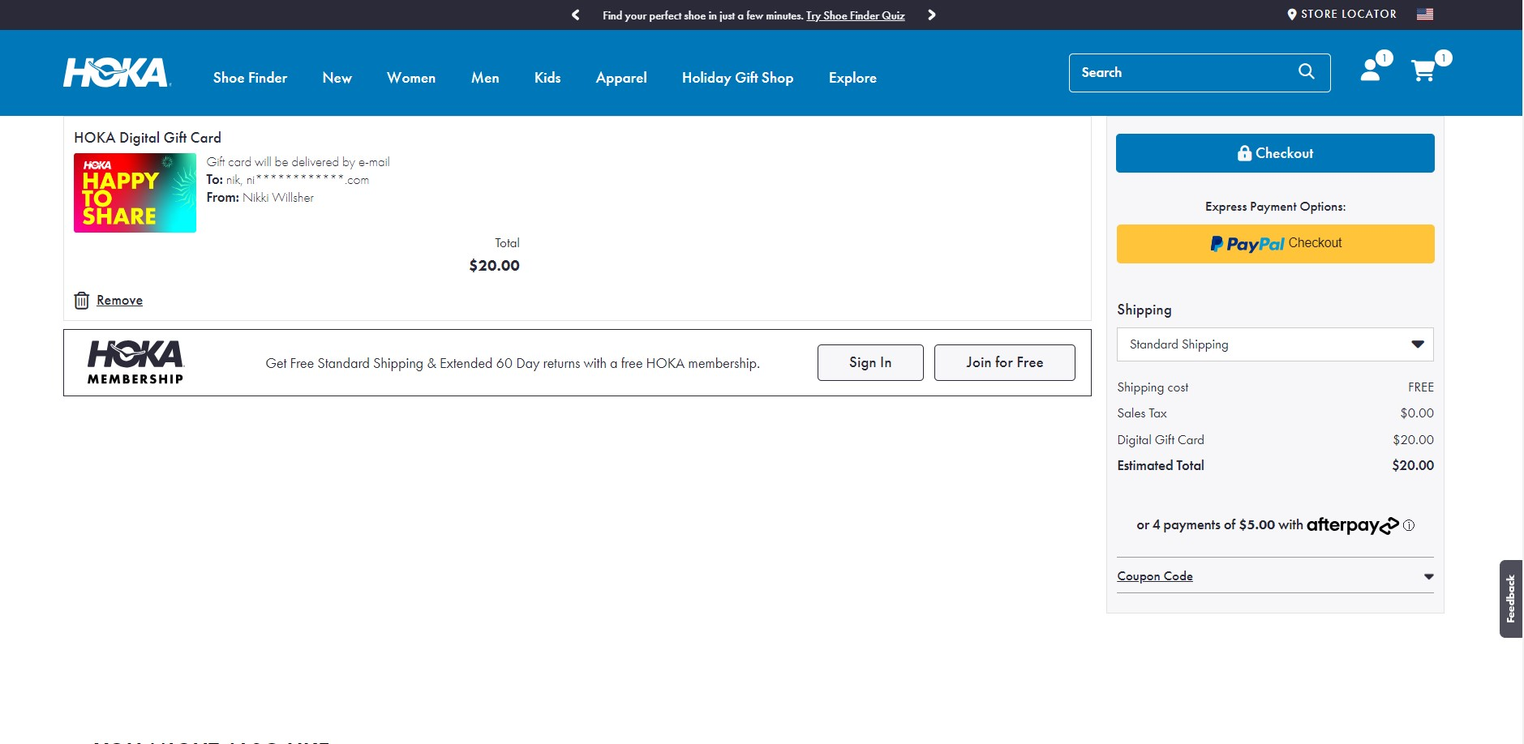

Slide 9
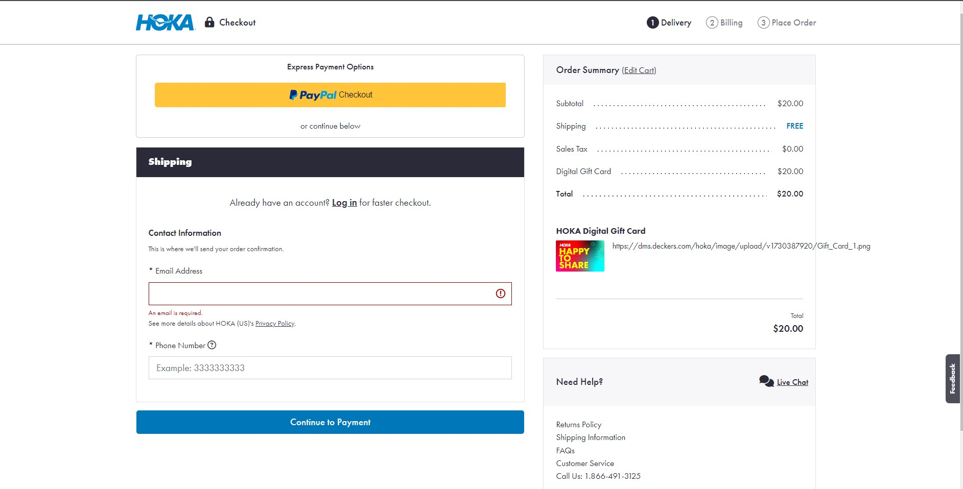

Slide 10
Email template – NA version

Slide 11
REDEMPTION

Slide 12
Redemption flow
Check Balance static page [footer incl]
Cart check [exclusions]
Checkout – BIN range validation
Order Conf page?
Payment method
Order conf email?

Slide 13


